Slide 1

Transfer Learning

Slide 2
Transfer Learning
Transfer learning involves taking a pre-trained neural network and adapting the neural network to a new, different data set.
Notes:
Further read - https://www.datacamp.com/community/tutorials/transfer-learning

Slide 3
The Four Main Cases When Using Transfer Learning
new data set is small, new data is similar to original training data
new data set is small, new data is different from original training data
new data set is large, new data is similar to original training data
new data set is large, new data is different from original training data

Slide 4
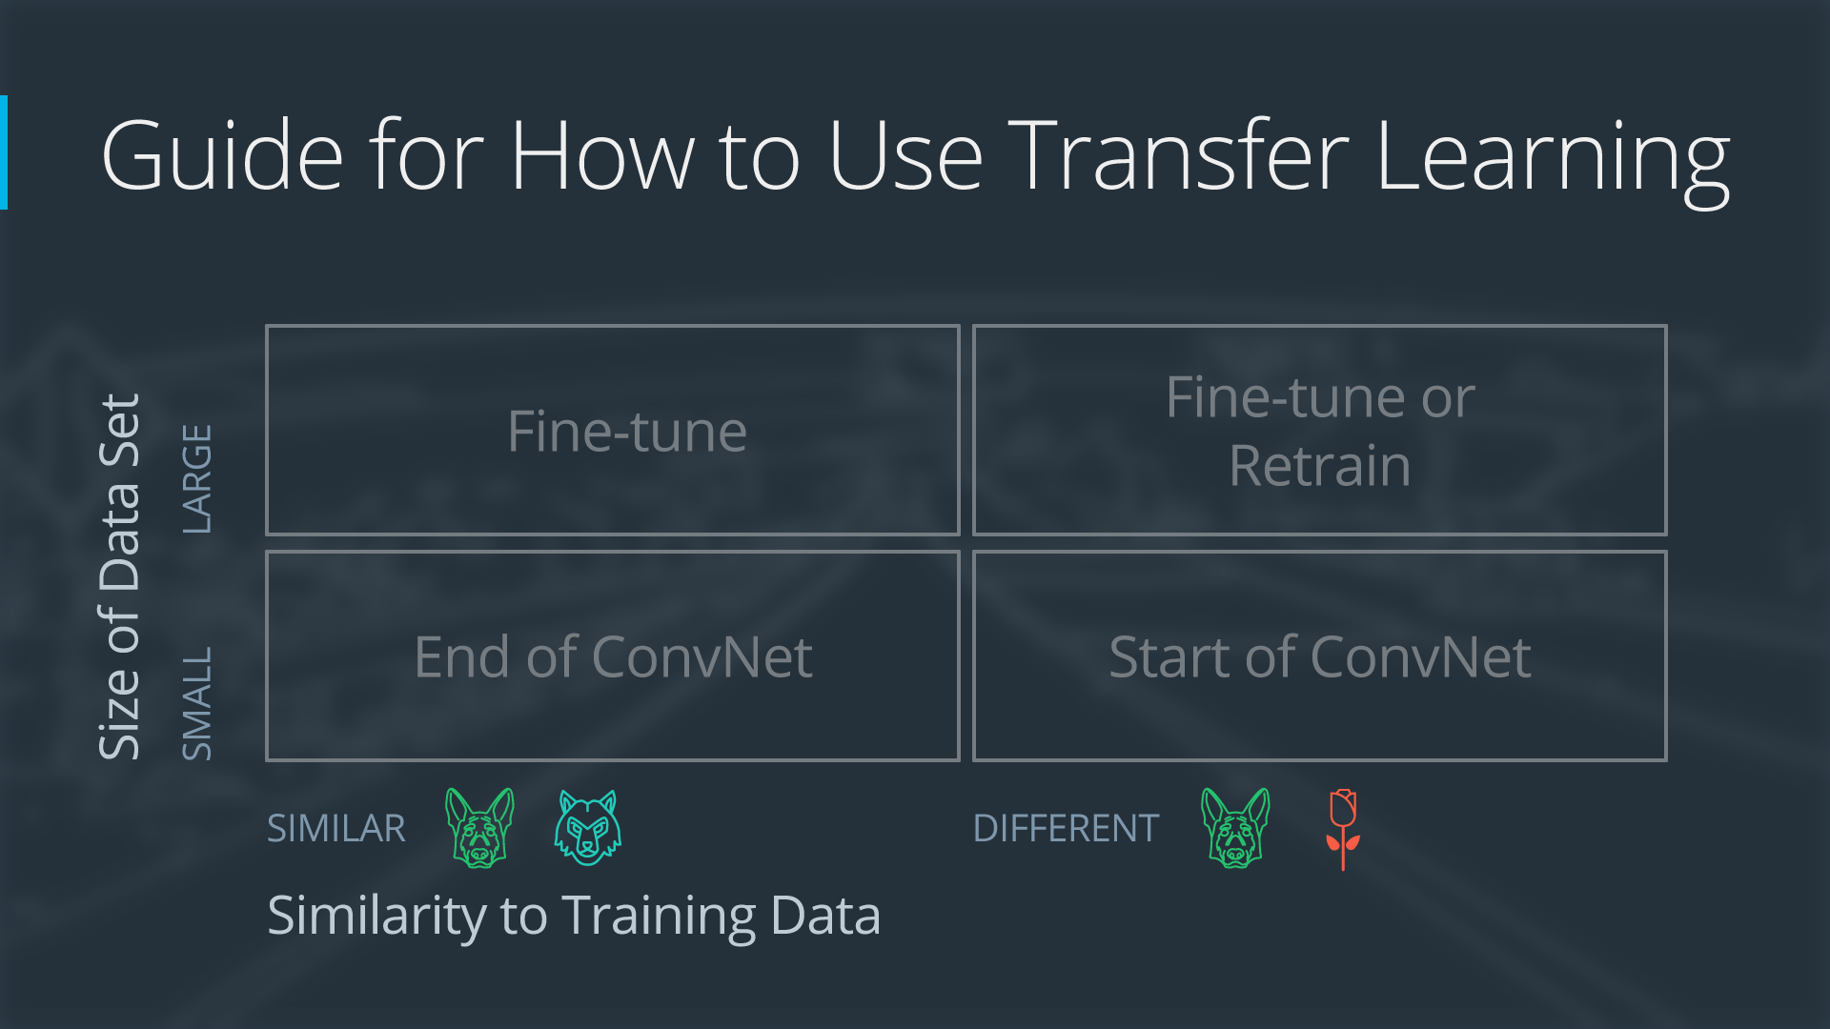

Slide 5
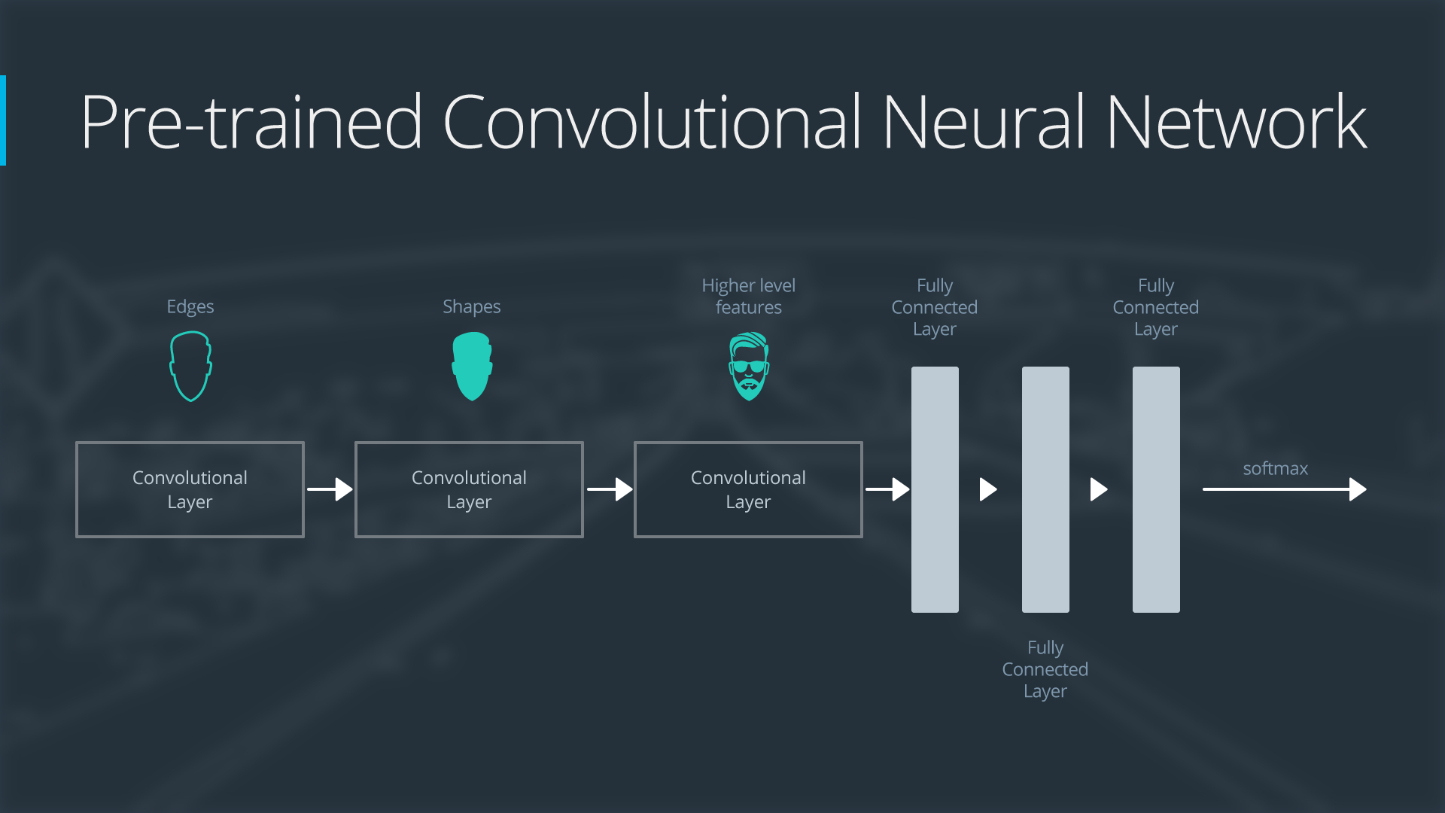

Slide 6
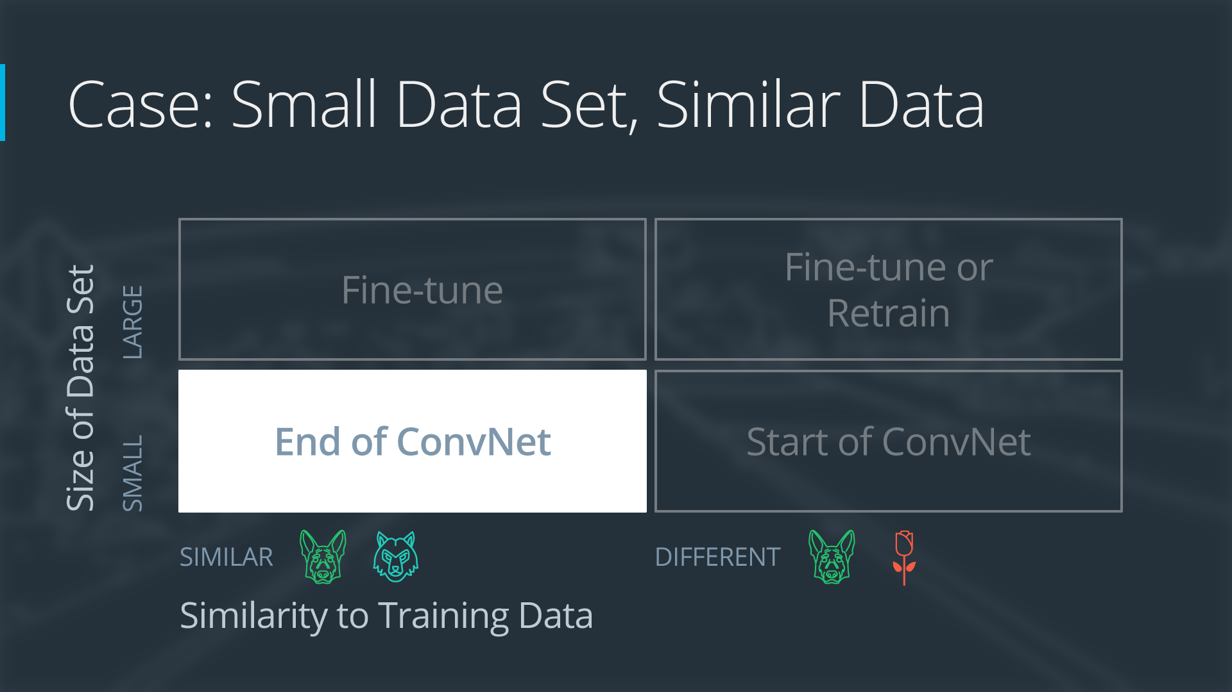
If the new data set is small and similar to the original training data:
slice off the end of the neural network
add a new fully connected layer that matches the number of classes in the new data set
randomize the weights of the new fully connected layer; freeze all the weights from the pre-trained network
train the network to update the weights of the new fully connected layer

Slide 7
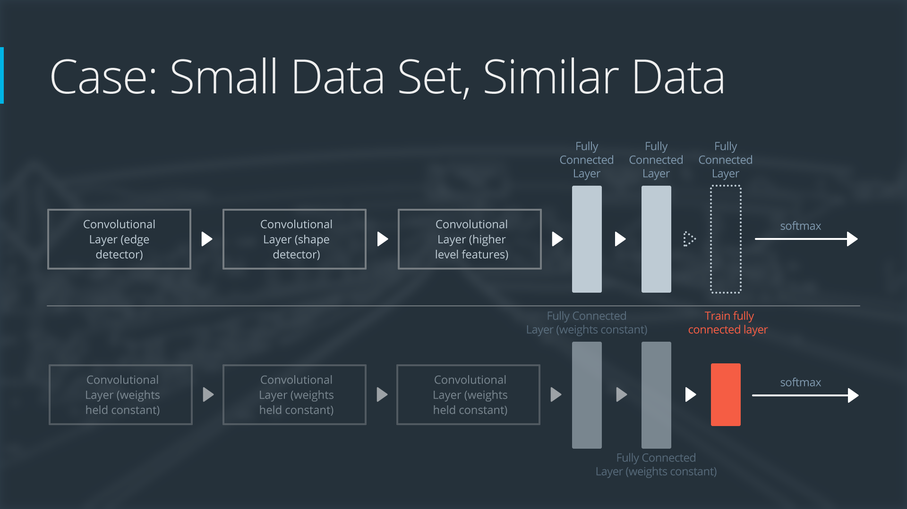

Slide 8
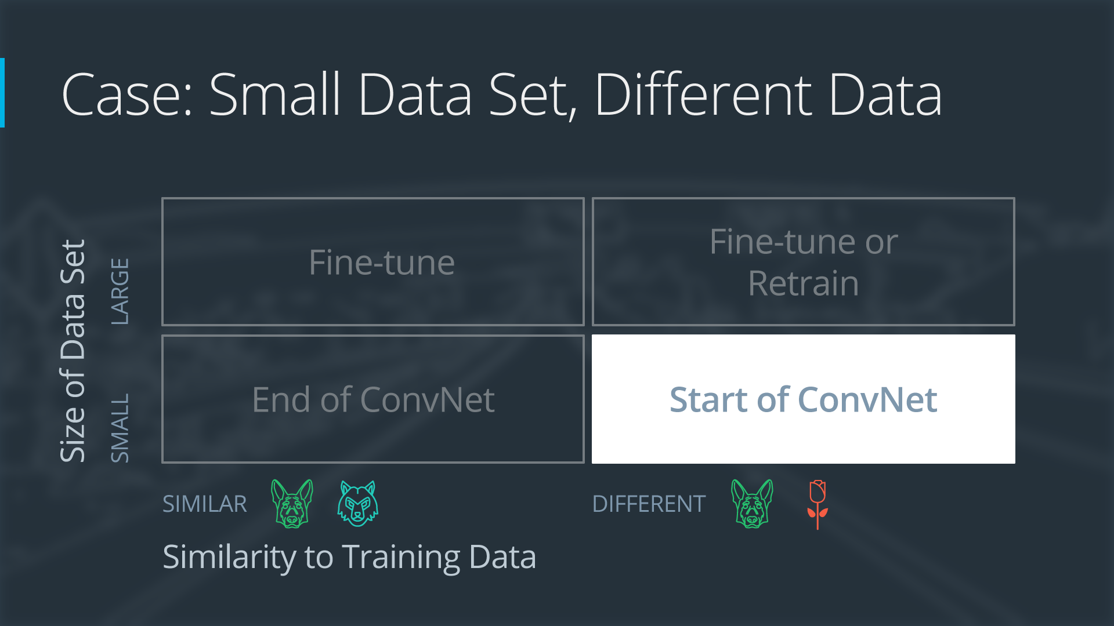
If the new data set is small and different from the original training data:
slice off most of the pre-trained layers near the beginning of the network
add to the remaining pre-trained layers a new fully connected layer that matches the number of classes in the new data set
randomize the weights of the new fully connected layer; freeze all the weights from the pre-trained network
train the network to update the weights of the new fully connected layer

Slide 9
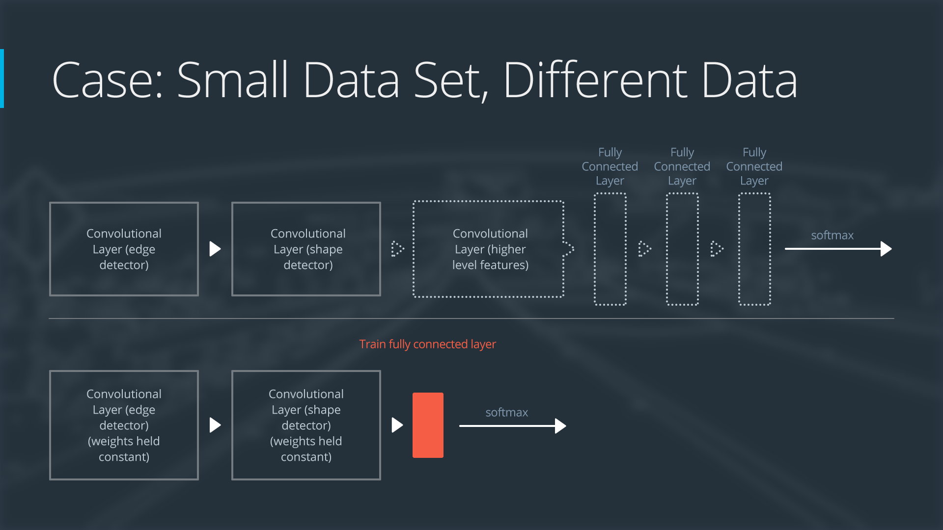

Slide 10
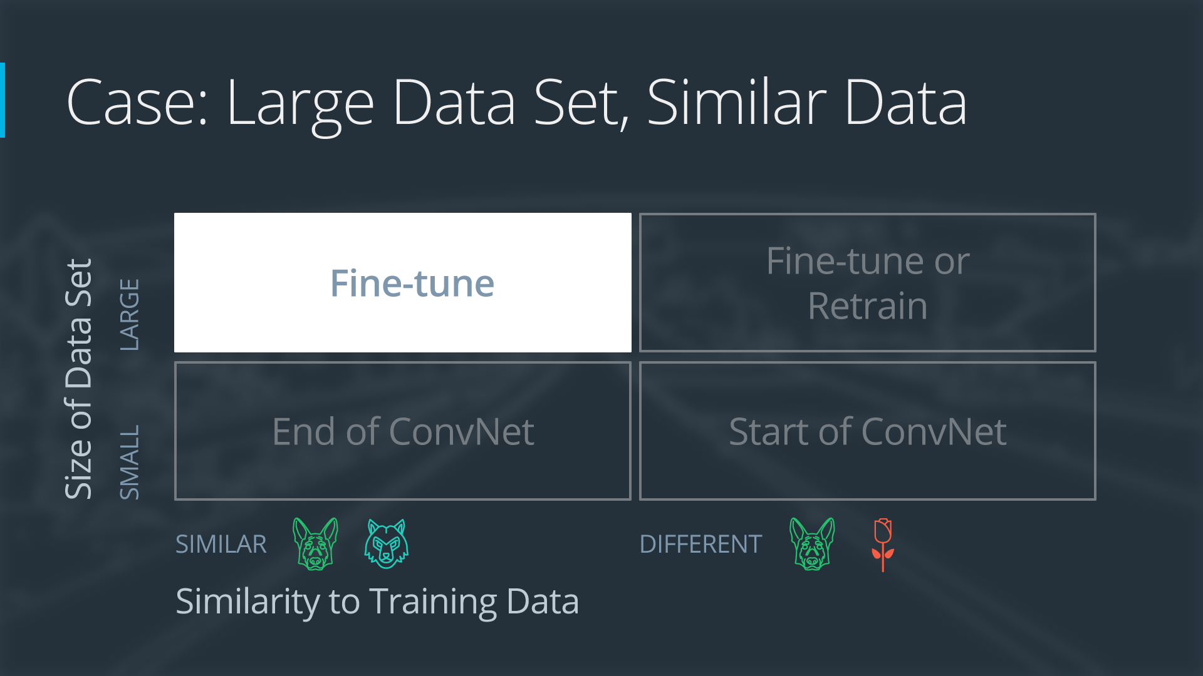
If the new data set is large and similar to the original training data:
remove the last fully connected layer and replace with a layer matching the number of classes in the new data set
randomly initialize the weights in the new fully connected layer
initialize the rest of the weights using the pre-trained weights
re-train the entire neural network

Slide 11
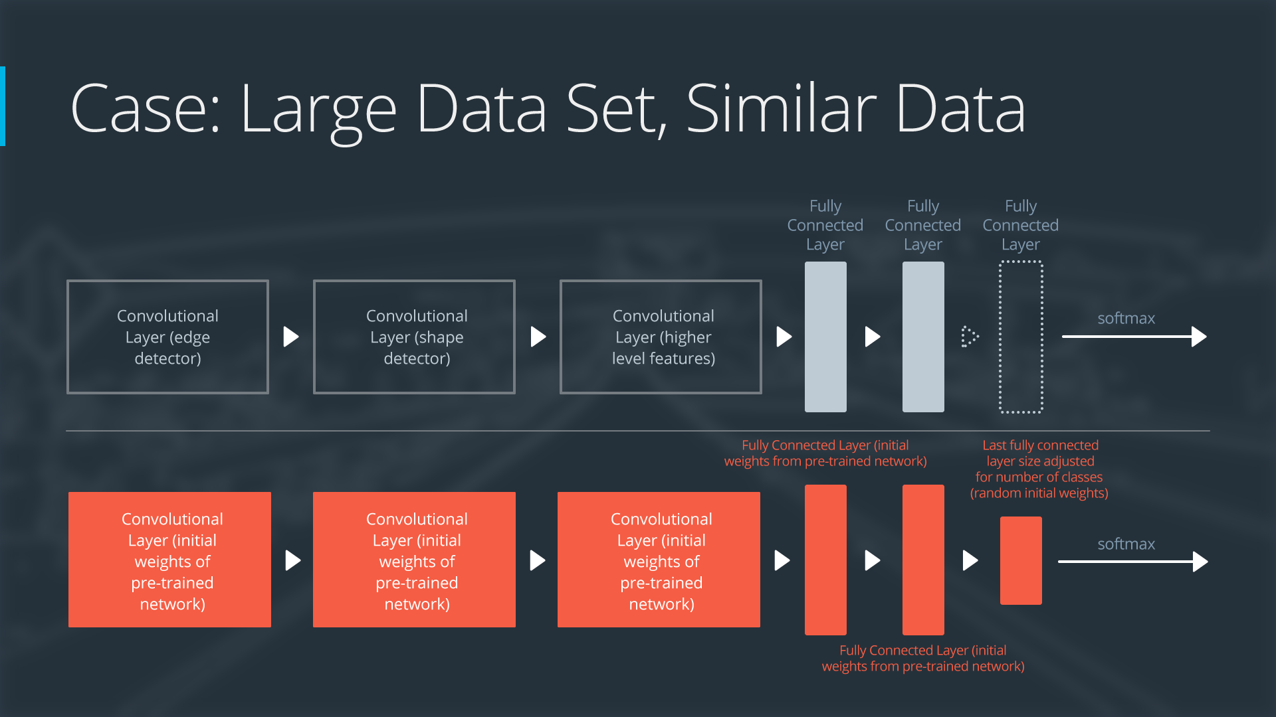

Slide 12
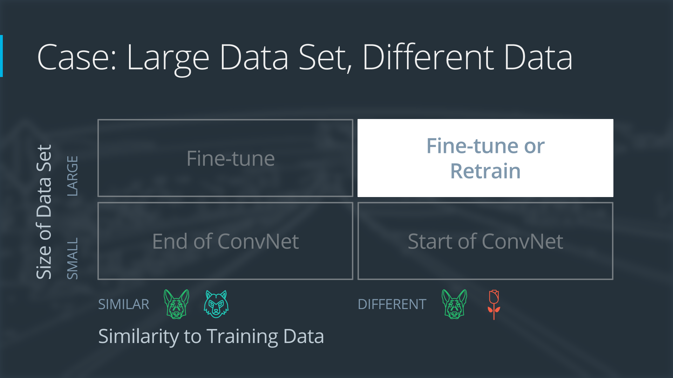
If the new data set is large and different from the original training data:
remove the last fully connected layer and replace with a layer matching the number of classes in the new data set
retrain the network from scratch with randomly initialized weights
alternatively, you could just use the same strategy as the "large and similar" data case

Slide 13


Slide 14
https://keras.io/applications/

Slide 15
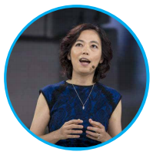
IMAGENET - WHERE HAVE WE BEEN?
In 2006, Fei-Fei Li started ruminating on an idea.
“We decided we wanted to do something completely unprecedented..
We’re going to map out the entire world of objects.”
Resulting dataset was called ImageNet.
Fei-Fei Li
Chief Scientist of AI/ML at Google Cloud; Associate Professor at Stanford, Director of Stanford A.I. Lab

Slide 16
IMAGENET
ImageNet project is a large visual database designed for use in visual object recognition software research.
ImageNet database was presented for the first time as a poster at the 2009 Conference on Computer Vision and Pattern Recognition (CVPR) in Florida.

Slide 17
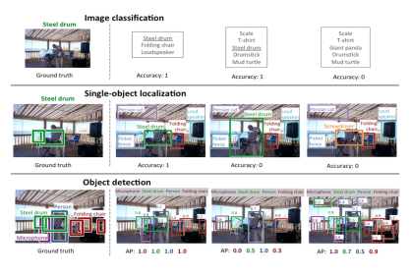
THE IMAGENET CHALLENGE - ILSVRC
Since 2010, the annual ImageNet Large Scale Visual Recognition Challenge (ILSVRC) is a competition where
1. Research teams evaluate their algorithms on given data set.
2. Compete to achieve higher accuracy on several visual recognition tasks

Slide 18
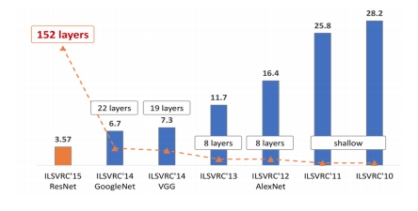
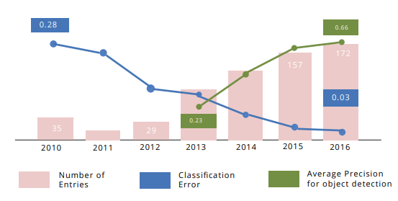
ILSVRC - EVOLUTION SINCE 2010

Slide 19
Popular CNN Architectures
LeNet
AlexNet
VGGNet
GoogleNet
Resnet

Slide 20
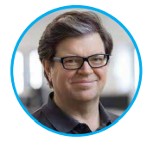
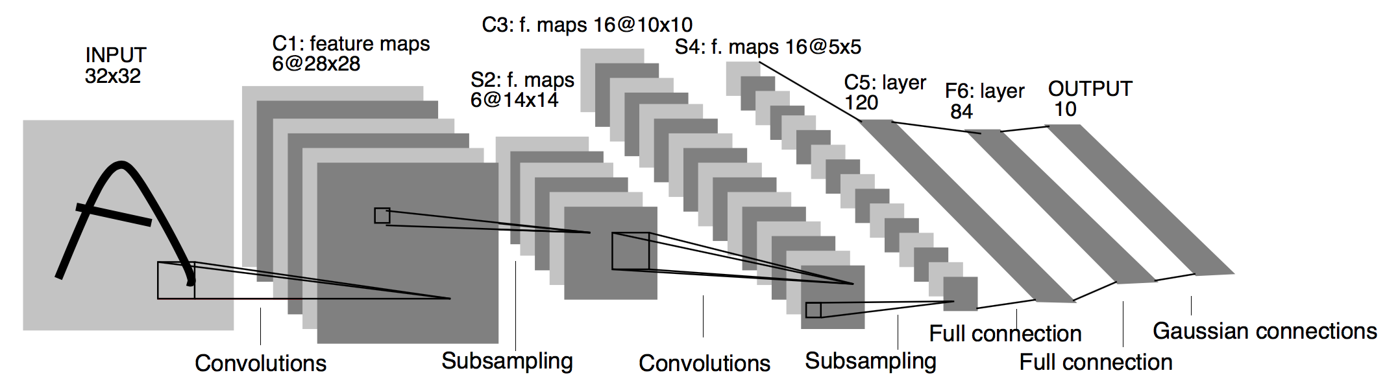
LeNet
Very first convolutional neural networks.
Pioneered by Yann LeCun .
Used mainly for character recognition tasks such as reading zip codes, digits, numbers on bank cheque etc

Slide 21
Advantages of LENET
LeNet architecture is simple.
Good at detecting hand written digits & characters.

Slide 22
DISADVANTAGES OF LENET
It’s not good for large data set.
Doesn’t perform good on large number of classes.
It doesn’t perform well on high resolution images.

Slide 23
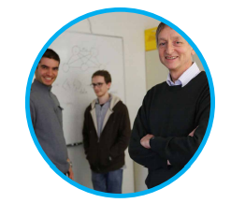
Alexnet
First Deep CNN.
Winner of ImageNet LSVRC-2012
Pioneers of AlexNet: Alex Krizhevsky, Ilya Sutskever, Geoffrey Hinton

Slide 24
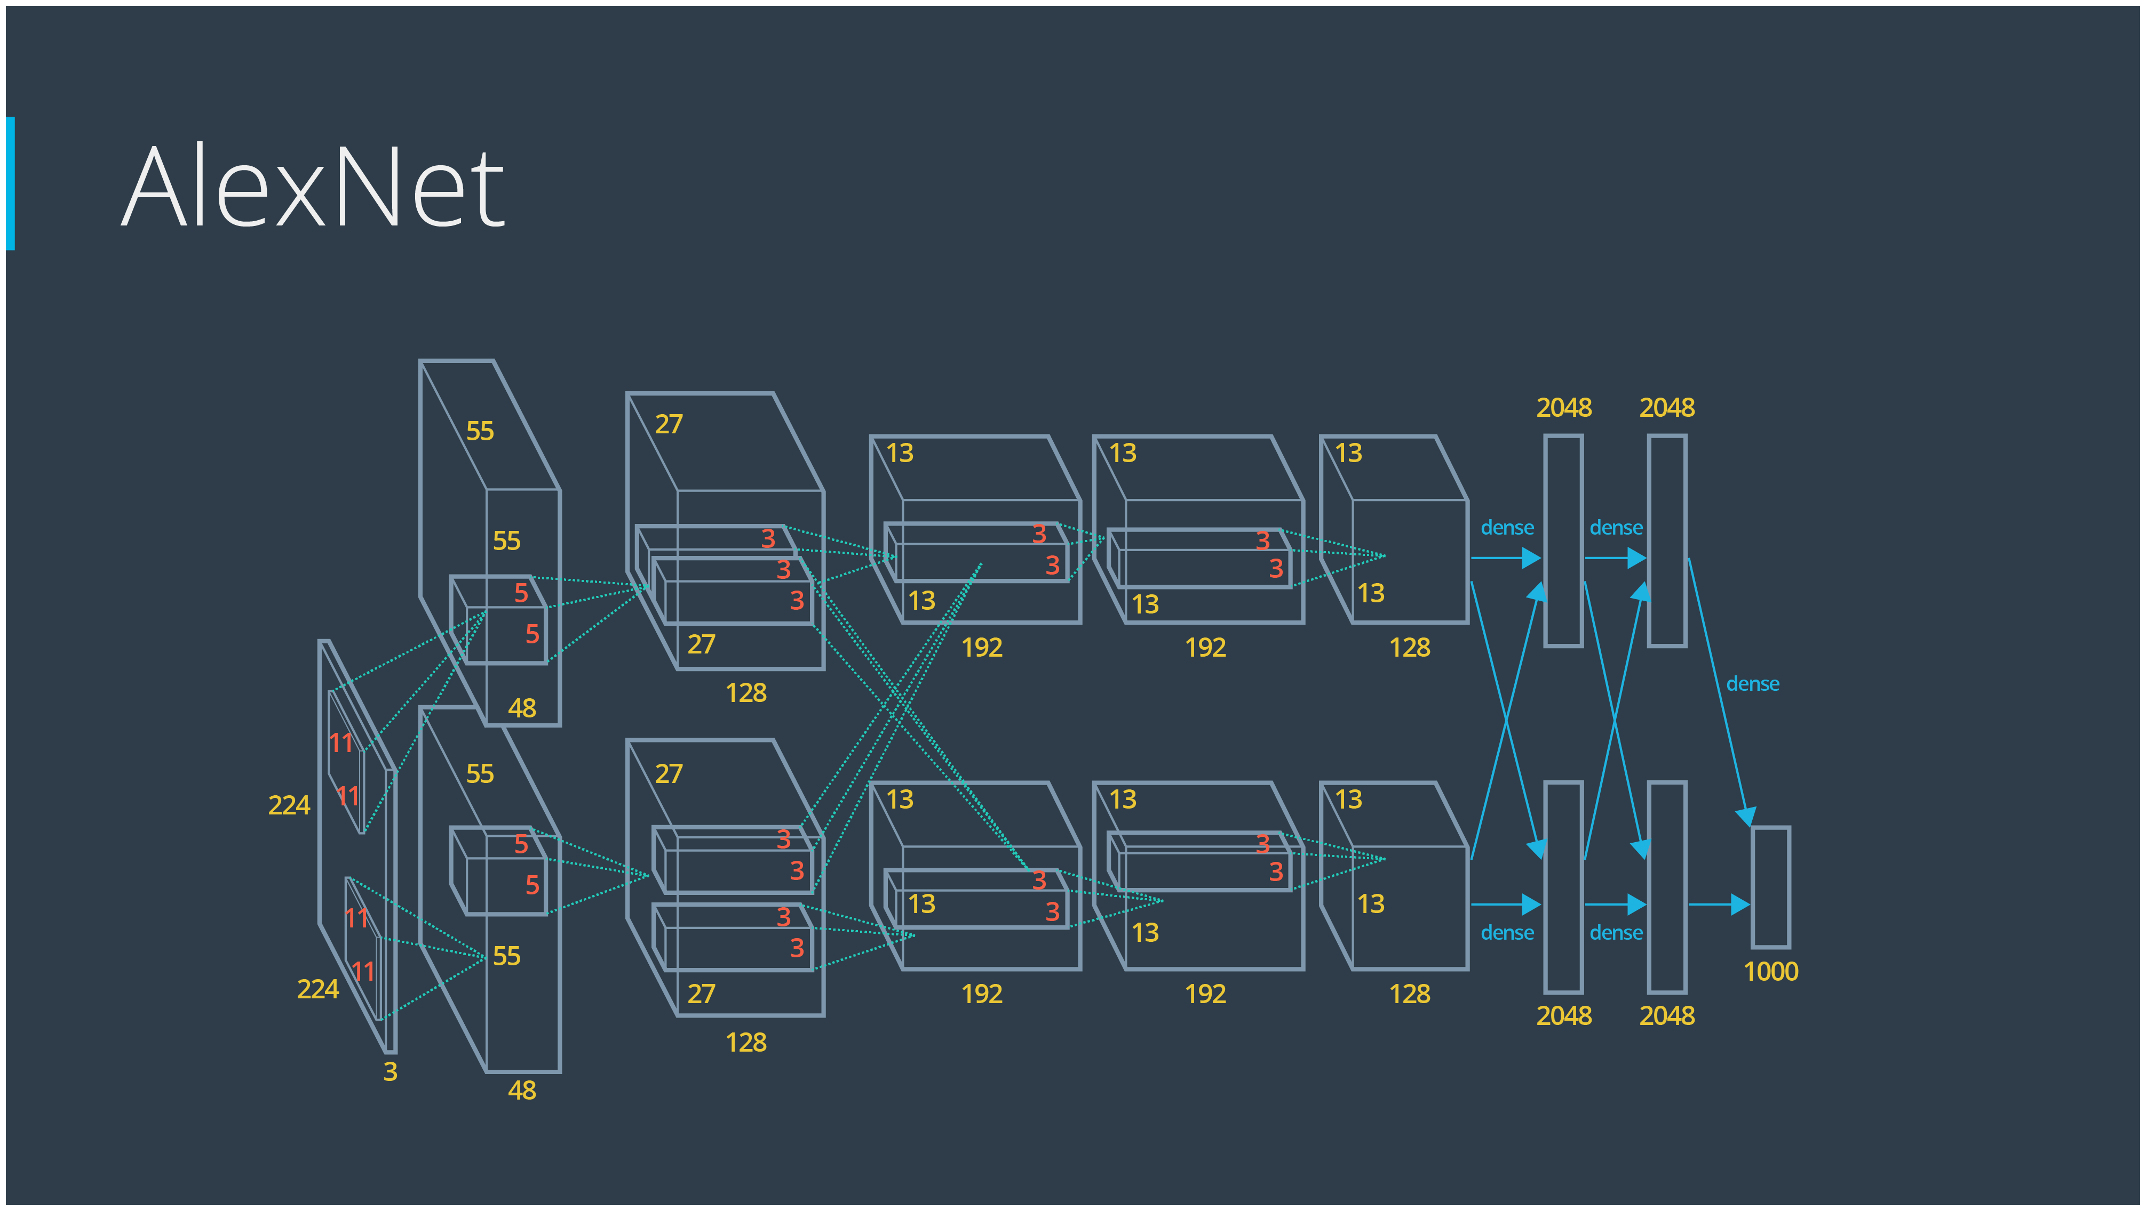

Slide 25
FEATURES OF ALEXNET
10 layers with 5 Conv,2 Maxpool and 3 FC layers.
It uses 11x11,5x5 and 3x3 filter size.
ReLU was used for the first time.
Used dropout instead of regularization to deal with overfitting.
Training time was doubled with the dropout rate of 0.5.
Heavy data augmentation due to different image processing techniques.

Slide 26
ADVANTAGES OF ALEXNET
Faster to train because it uses ReLU activation function.
Uses Dropout which helps in overcoming over-fitting.
DISADVANTAGES OF ALEXNET
Being a large network it produces 20 million trainable parameters which are computationally expensive.

Slide 27
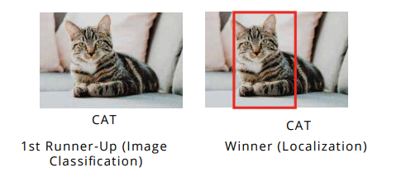
VGGNet
VGGNet is a neural network that performed very well in the Image Net Large Scale Visual Recognition Challenge (ILSVRC) in 2014.

Slide 28
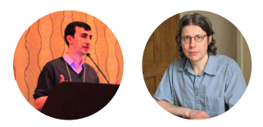
WHO DEVELOPED VGGNET
VGGNet is invented by VGG (Visual Geometry Group),an academic group (Simonyan and Zisserman) focused on computer vision from University of Oxford.

Slide 29
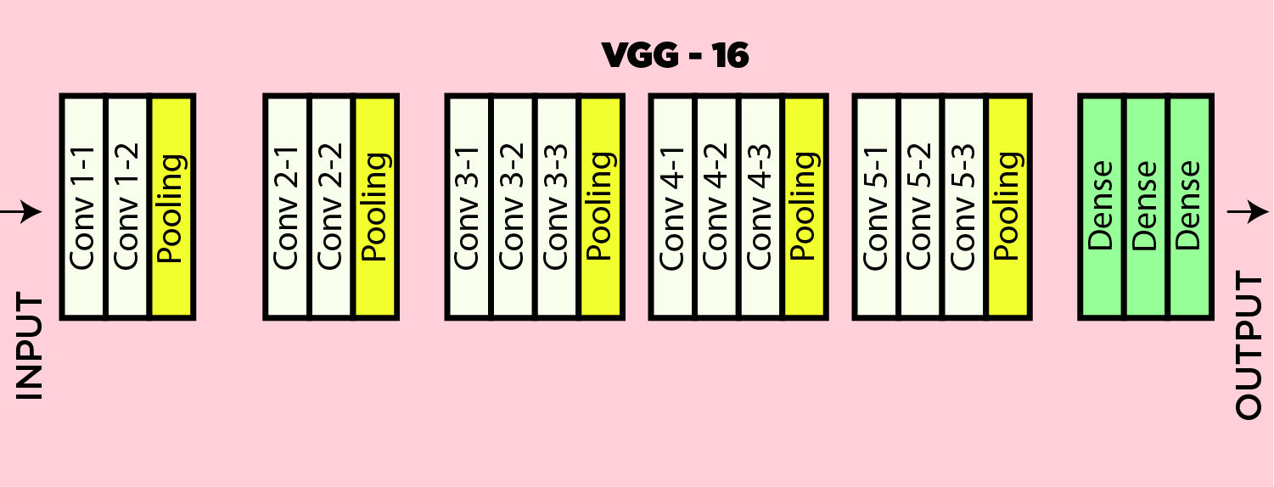
VGG 16
VGGNet consists of 16 Convolutional layers and is very appealing because of its simplicity.

Slide 30
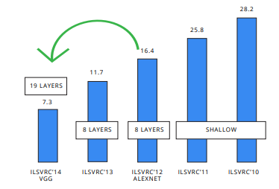
VGG - ERROR RATE IN ILSVRC 2014
Though VGGNet is the first runner-up, not the winner of the ILSVRC 2014 in the classification task, which has significant improvement over ZFNet (The winner in 2013) and AlexNet (The winner in 2012).

Slide 31
ADVANTAGE OF VGG
Very good architecture for benchmarking image classification/ localization.
Pre-trained networks for VGG are freely available on the internet, so it is commonly used for various applications.
DISADVANTAGE OF VGG
Slow to train if trained from scratch. Even on a decent GPU, it takes more than a week to get it to work.

Slide 32
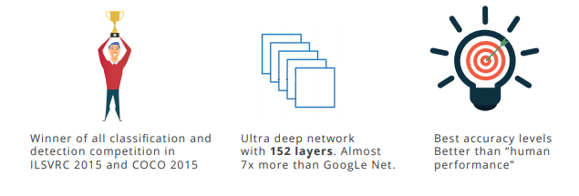
RESNET

Slide 33
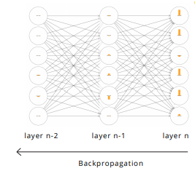
Issues with Deeper networks
During the backpropagation process, the gradient update decreases as we go deeper in the network.
In deeper layers, the gradient update reduces to zero and the layers don’t learn new weights.
This is why deeper models don’t perform as good as shallow model.

Slide 34
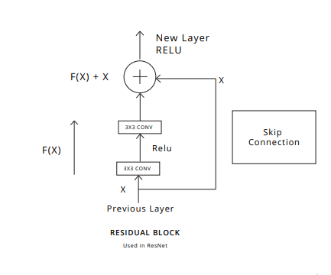
HOW TO RESOLVE VANISHING GRADIENT PROBLEM
Skip connections are shortcut connections which skip few convolutional layers.

Slide 35
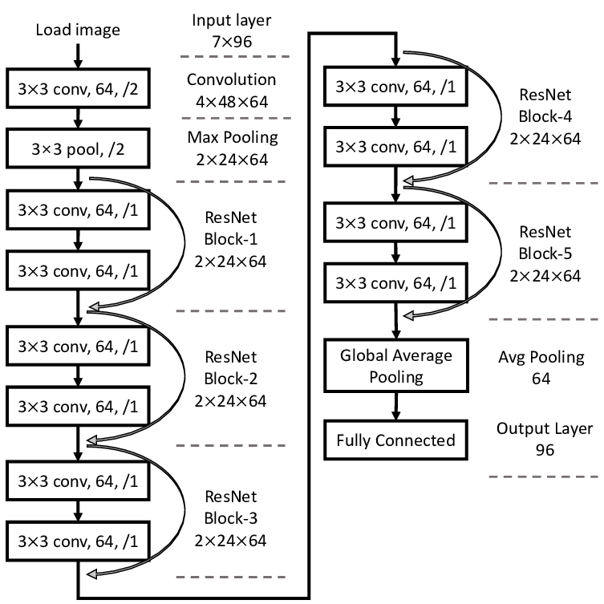
RESNET
ResNet architecture is a combination of Residual Blocks.
You can stack more blocks to make it deeper.

Slide 36
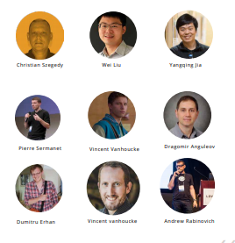
Googlenet
GoogleNet was the winner of ImageNet 2014, where it proved to be a powerful model.
GoogleNet (or Inception Network) is a class of architecture designed by researchers at Google.

Slide 37
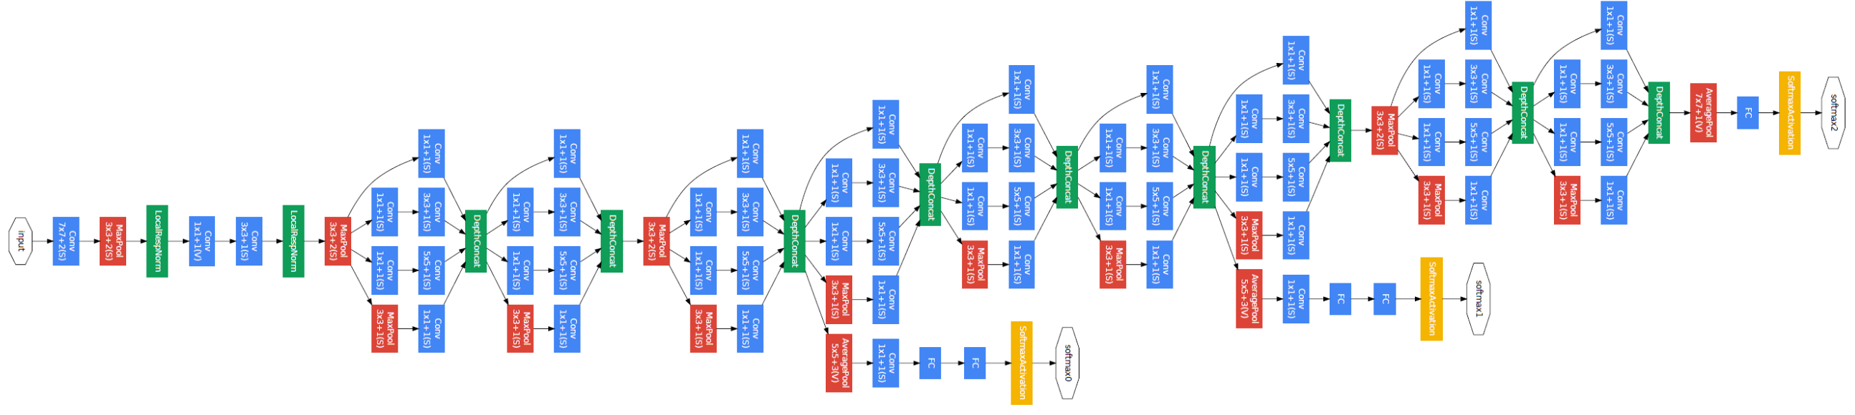
Googlenet
Consists of a 22 layers deep CNN
12 times fewer parameters than AlexNet
High Performance(top-5 error rate 6.77%)

Slide 38
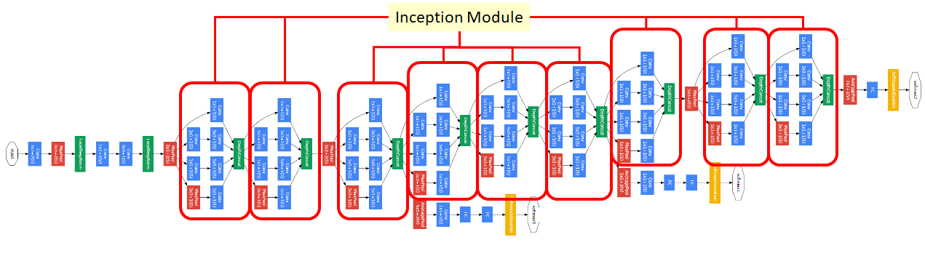
INCEPTION

Slide 39
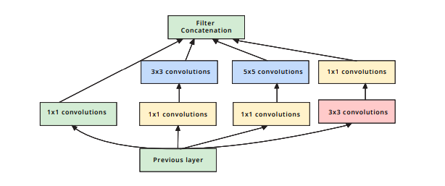
INCEPTION (NETWORK IN A NETWORK)

Slide 40
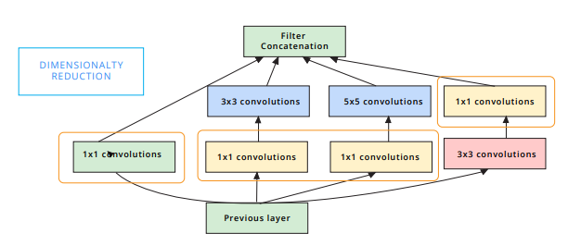
GOOGLENET (INCEPTION)

Slide 41
More reads
https://www.datacamp.com/community/tutorials/transfer-learning

